Slide 1
People Spacer
by
Prateek Pradhan
Aakash Dixit
Shubhanker Mehta
Ishaan Singh Bains

Slide 2
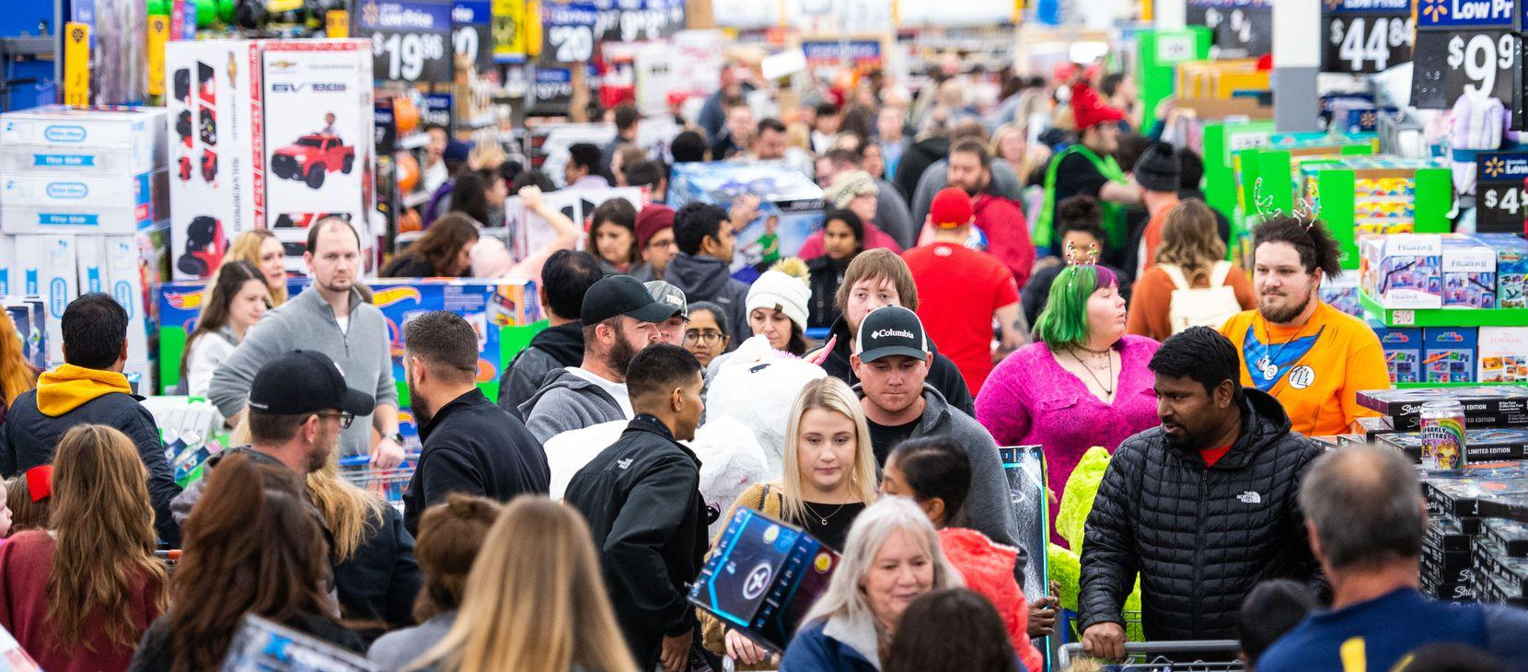
The world with OverCrowding
Can we shop, eat and go out while following social distancing, Is that possible

Slide 3

Working of the People Spacer:
It is a device that is attached to the entry/exit points
The device counts number of people present in a location
Helps with limiting the number of people entering a location
Provides warning message incase of overcrowding
Works great in Pandemic situations to help instate social distancing in People

Slide 4
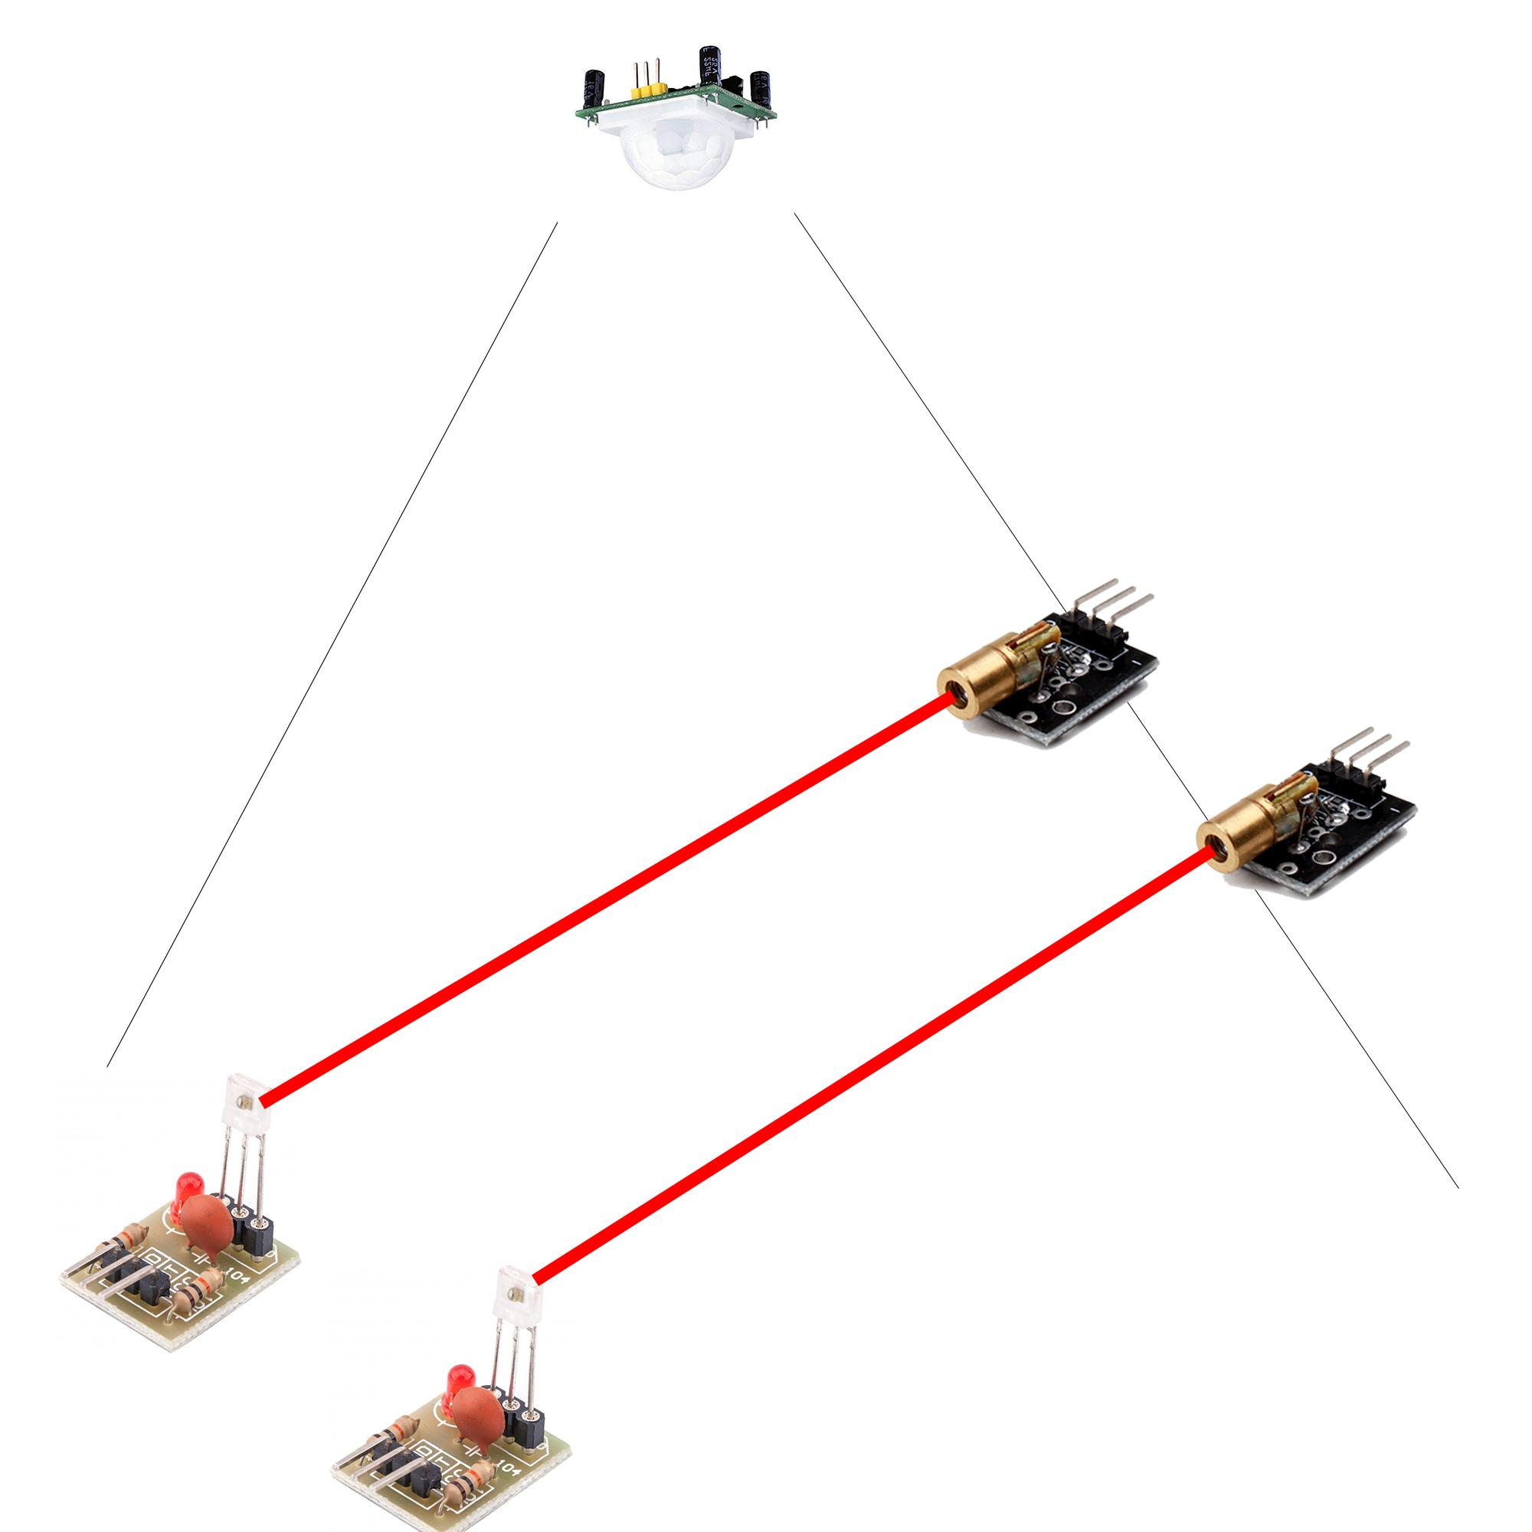
Equipment required:
Arduino
ESP8266
PIR Sensor
KY008 Laser Transmitter
Laser Detector Module
Connecting Wires

Slide 5
Advantages of using People Spacer:
Inexpensive
Easily made
High functioning
Highly scalable
Flexible in use

Slide 6
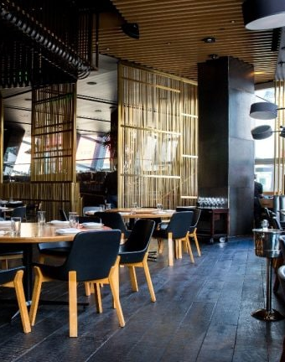
Places People Spacer can be used
College
Grocery Shops
Bakeries
Malls
Clubs
Bars
Restaurants
Food Courts

Slide 7
Integrations in the device
Thermopile to check the temperature of people
Cloud system to send a message directly to the authorities incase of violation of person limit in an area
Alarm to avoid infected people

